Slide 1
Who am I?
By: Katelyn Morrey

Slide 2
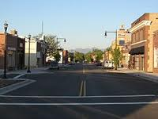
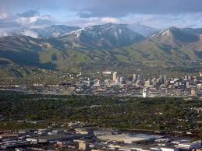
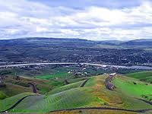
Where have I lived?
West Valley
Magna
Clarkston Washington

Slide 3
What school did I go to?
1-2 and 4th grade I went to West Valley Elementary
3rd grade I went to Magna Elementary
5-6th grade I went to Highland Elementary
7-8th grade I went to Brockbank Jr. High

Slide 4
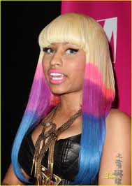
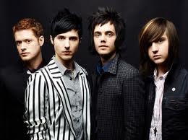
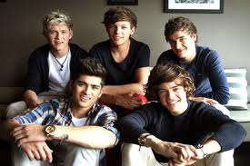
My Favorite Music
Pretty much any type of music

Slide 5
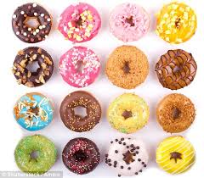
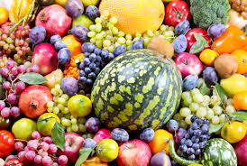
My favorite foods are
I’m not a very picky person

Slide 6
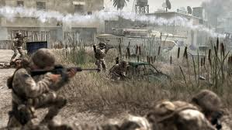
My hobbies
Playing COD and Modern War Fare
Drawing

Slide 7
My goals for school
To get good grades

Slide 8
