Slide 1
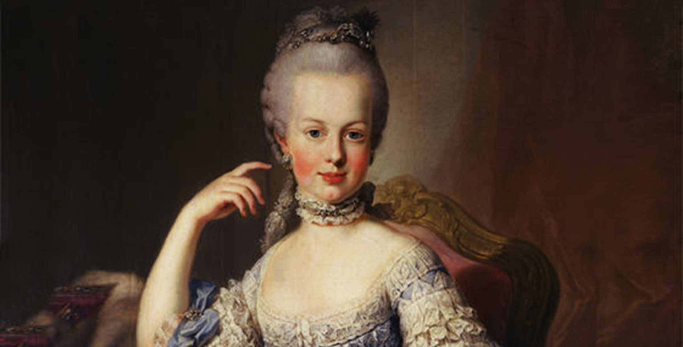
Marie Antoinette
By: Katelyn Morrey

Slide 2
Full name: Maria Antonia Josepha Johanna.
Father: Francis 1, Holy Roman Emperor.
Mother: Empress Maria Theresa.
Known as Marie Antoinette of Austria, Marie Thérèse, Duchess of Anegoulême, and Madame DÉFICIT.

Slide 3
Married to Louis XVI (1770-1793)
Born on November 2, 1755 at Hofburg Palace, Vienna, Austria.
Died on October 16, 1793 at the age of 37 at Place de la Révolution, Paris, France. Died by the guillotine.
Burial: January 21, 1815 at Saint Denis Basilica, France.

Slide 4
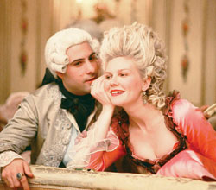

Slide 5
The People were first charmed by Marie Antoinette’s personality and beauty, the people came to dislike her.
They accused her of having sympathies for France’s enemies particularly Austria.
She was also accused of the Diamond Necklace incident damaged her reputation, although she was completely innocent in this affair.
She was held Responsible for France’s financial crisis.

Slide 6
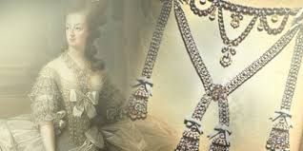

Slide 7
Marie Antoinette had four children her first was a baby girl named Marie Thérèse who Sent her mom into a fit after 12 hours of labor named after her mother, the second was a baby boy named Louis Joseph the heir to the throne, the third was another baby boy named Louis Charles, and then another baby girl named Sophie who died a month before her first birthday. Marie Thérèse the oldest of Marie Antoinette’s children, a true orphan with her parents killed and her siblings all dead, she was left for a time alone in the Temple prison, before she was finally released at the age of 17 in December of 1795. she spent most of her life exiled from France, she was bitter and angry thanks to her past.

Slide 8
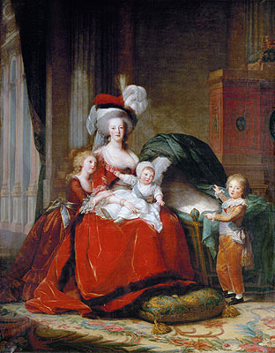

Slide 9
